Slide 1
Lecture 13
COMP207

Slide 2
Overview
Weekly assessment
Practical SQL assessment
Weekly survey
Week 7 module will only be covered Thursday!
A bit more on index
Optimizing query plans
Physical query plans

Slide 3
Practical SQL assignment
How to find what error you made if CodeGrade says a table is missing:
  Click on > besides Setup, scroll down to Per Student Setup and then click on stderr
Plagiarism: Is it a good idea?
  Every year a few % get caught
  They get 0 on their assessment (or course if they did it before – or perhaps get thrown out of the programme)
  If you first start now, you should still easily be able to do the first few and get a passing mark. It might be hard to do 5-7 (getting your grade from 70 to 100) though if you have not spent any time on SQL before

Slide 4
Weekly survey
No answers this week
  I imagine most are working on the assignment

Slide 5
Week 7 module = only covered Thursday!
We have 10 weeks of material and used the first lecture on an overview…
  (There is also the lesser problem that I would like to use some time for feedback on the SQL assignment + a bit directly about the exam)
  Feedback is coming Tuesday, not next week but the week after
Week 7 is small anyway, so I chose that to be short…

Slide 6
More on index
What are Hash index and B++ tree index?
Hash index depends on how many values N you want to store
  That said if you end up storing a factor more/less, you just redo the computation, which, due to the factor does not end up costing much more
Given a value you want to store, you do some computation that will produce a (mostly) unique key x from 1 to N and store it in spot x
We can then find if we have a given value by doing the same computation again and see if anything is stored in spot x
  Hence, fast for doing equalities but can’t really do anything else

Slide 7
Single Level vs Multi-Level Indexes
Single level index: stored in single list
Multi-level index: distributed across
different layers
Value | Pointers
11 | …
21 | …
31 | …
… | …
Value | Pointers
101 | …
201 | …
301 | …
… | …
Value | Pointers
1 | …
2 | …
3 | …
… | …
Value | Pointers
1001 | …
2001 | …
3001 | …
… | …
Value | Pointers
111 | …
121 | …
131 | …
… | …
Value | Pointers
1101 | …
1201 | …
1301 | …
… | …
Level 1
…
Single-level index
Level 3
…
Level 2

Slide 8
B+ Tree: Leaves (Idea)
sorted in
increasing order
a₁
a₂
…
a_{n}
next leaf
Points to tuples
with value a₁
Points to tuples
with value a₂
Points to tuples
with value a_{n}

Slide 9
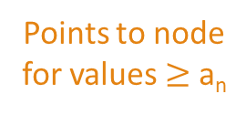
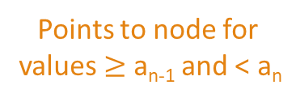
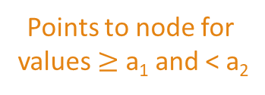
B+ Tree: Inner Nodes (Idea)
sorted in
increasing order
a₁
a₂
…
a_{n}
Points to node
for values < a₁
Points to node for
values $≥$ a₁ and < a₂
Points to node for
values $≥$ a_{n-1} and < a_{n}
Points to node
for values $≥$ a_{n}
Pointers point to B+ tree nodes at level below

Slide 10
A B+ Tree Index
Four searches:
19
>19
<19
[19,38]
13
7
23
31
43
2
3
5
7
11
13
17
19
23
29
31
37
41
43
47
(Example from ”Database Systems: The Complete Book”)

Slide 11
Index over multiple attributes
If you have an index over a, b it is basically like having one index over a#b
  Perhaps easier for some: if a and b are single digit numbers, you have a search tree over a*10+b

Slide 12
Optimizing query plans
There are many tricks for this, but we saw just 3:
  Push projections (i.e. remove columns) as far down as possible
    That way you have less data to keep track of
  Push selections (i.e. like WHERE in SQL) as far down as possible
    Again always less information to keep track of
  Combine selections that are over both sides in a join into an equi-join – join where you also have some condition (basically combing the operations)
    We can then do some tricks with sorting to speed up these joins

Slide 13
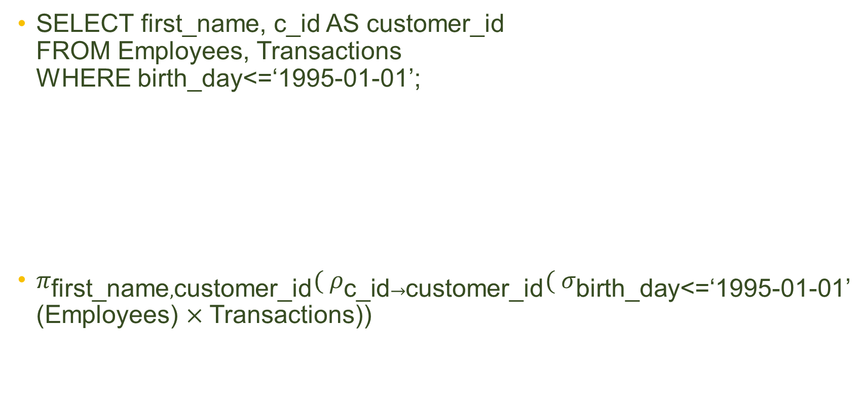
Example
Employees
birthday | first_name | family_name | e_id
1990-11-10 | Anne | Smith | 1
2000-02-05 | David | Jones | 2
1995-05-09 | William | Taylor | 3
SELECT first_name, c_id AS customer_id
FROM Employees, Transactions
WHERE birth_day<=‘1995-01-01’;
$π_{\text{first}\text{_}\text{name},\text{customer}\text{_}\text{id}}( ρ_{\text{c}\text{_}\text{id}→\text{customer}\text{_}\text{id}}( σ_{\text{birth}\text{_}\text{day}\text{<=‘1995−01−01’}}$(Employees) $×$Transactions))
Transactions
t_id | c_id | e_id
1 | 3 | 1
2 | 6 | 1
3 | 19 | 3

Slide 14





Query plans
$π_{\text{first}\text{_}\text{name},\text{customer}\text{_}\text{id}}( ρ_{\text{c}\text{_}\text{id}→\text{customer}\text{_}\text{id}}( σ_{\text{birth}\text{_}\text{day}\text{<=‘1995−01−01’}}$(Employees) $×$Transactions))
$$π_{\text{first}\text{_}\text{name},\text{customer}\text{_}\text{id}}$$
first_name | Customer_id
Anne | 3
Anne | 6
Anne | 19
$$ρ_{\text{c}\text{_}\text{id}→\text{customer}\text{_}\text{id}}$$
Birth_day | first_name | Family_name | Employees. e_id | t_id | c_id | e_id
1990-11-10 | Anne | Smith | 1 | 1 | 3 | 1
1990-11-10 | Anne | Smith | 1 | 2 | 6 | 1
1990-11-10 | Anne | Smith | 1 | 3 | 19 | 3
$$σ_{\text{birth}\text{_}\text{day}\text{<=‘1995−01−01’}}$$
$$×$$
birthday | first_name | family_name | e_id
1990-11-10 | Anne | Smith | 1
Transactions
t_id | c_id | e_id
1 | 3 | 1
2 | 6 | 1
3 | 19 | 3
birthday | first_name | family_name | e_id
1990-11-10 | Anne | Smith | 1
2000-02-05 | David | Jones | 2
1995-05-09 | William | Taylor | 3
Employees
Employees
Transactions

Slide 15
Physical query plans
Many operations have multiple ways that they could be done in
A physical query plan is meant to tell us what to do exactly
  Do we use the index?
  Which way to join things/which way to do other operations?
  How do we exchange information between operations?
  What about which order we join in if there are multiple joins?
We try to estimate how good these are and then select the one that looks cheapest

Slide 16

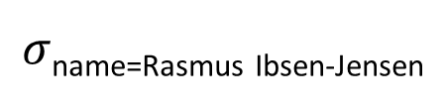

Example where join order matters
SELECT *
FROM Lecturers NATURAL JOIN Modules NATURAL JOIN Students
WHERE Lecturers.name = Rasmus Ibsen-Jensen
$$⋈$$
$$⋈$$
$σ$_{name=Rasmus Ibsen-Jensen}
Students
Modules
Lecturers

Slide 17


Example where join order matters
SELECT *
FROM Lecturers NATURAL JOIN Modules NATURAL JOIN Students
WHERE Lecturers.name = Rasmus Ibsen-Jensen
$$⋈$$
$$⋈$$
$σ$_{name=Rasmus Ibsen-Jensen}
Students
Modules
Lecturers

